Slide 1
What makes a game app successful?
A guide by Chip Heath & Dan Heath
Notes:
Our group decided to look at phone app data, targeting specifically on games and see what features are drivers to success.
-Reason for selected the topic:
The reason we chose this topic is because we were interested to utilize the things we learned into real life application and were generally interested in how ratings for phone apps come about.

Slide 2

Success factors
-Ratings
-Number of installations
Notes:
Ratings:
-Qualitative measure for user enjoyment
-Weakness: Results may be skewed where very little votes influence the final result and may not be the 'true' rating i.e. need
large enough votes to get more accurate assessment of rating
-To mitigate weakness, establish threshold with # of minimum reviews that is adjusted for time
Number of Installs
-Quantitative measure of how many users are interested/engaged in game
-Weakness: Only given absolute measure and therefore influenced by time (should be inverse log relationship over time)
-To mitigate weakness, adjust the installs for time i.e. average out total installs per year, and measure against same segment (year)

Slide 3

Through this project we are hoping to find out what are the main features that cause a game app to succeed
Selling your idea
Notes:
We will first preprocess the given dataset that will then be put through a machine learning algorithm to help build a model that will determine a game app's rating. A successful model will allow for real life application where mobile game creators can use this to tune their game for greater chance of success e.g. if having games free is a factor in determining higher game rating, then creators should reconsider their pricing strategies.

Slide 4


Benchmarks
Database/Pre-Processing
Machine Learning
GitHub Structure/Communication Protocol

Slide 5
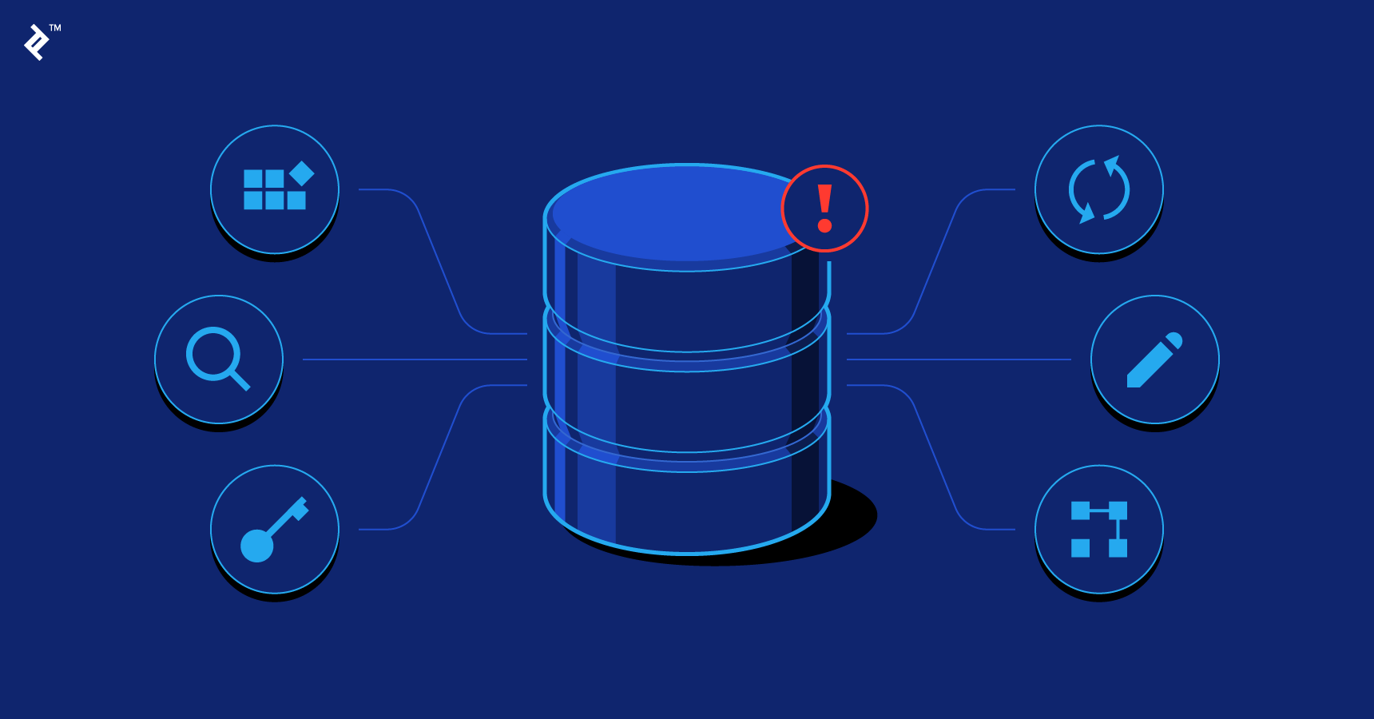
Database/Preprocessing
Notes:
Progress so far:
-Removed extra columns that we felt weren't necessary -Transformed a number of rows on number reviews column, where some numerical values are objects and were transformed accordingly -Removed erroneous rows on numer reviews columns i.e. objects -Removed rows where number reviews is less than 1,000, as ratings may not be reflective with lower reviews (still debating about) -Export file as csv

Slide 6

Machine Learning
Notes:
Progress so far:
-Removed extra columns that are not needed for machine learning -Encoded categorical columns -Ran linear regression analysis and obtained r^2 accuracy -Ran p-values off linear regression
Plans:
-Add additional features and run model -Should run logistical instead of linear model -Use supervised learning to compute produce model e.g. random forest -Use neural network to produce better model due to complexity of features
-Use regression of features against our metric
-Use random forest against our metric
-Use PCA for features into random forest against our metric

Slide 7
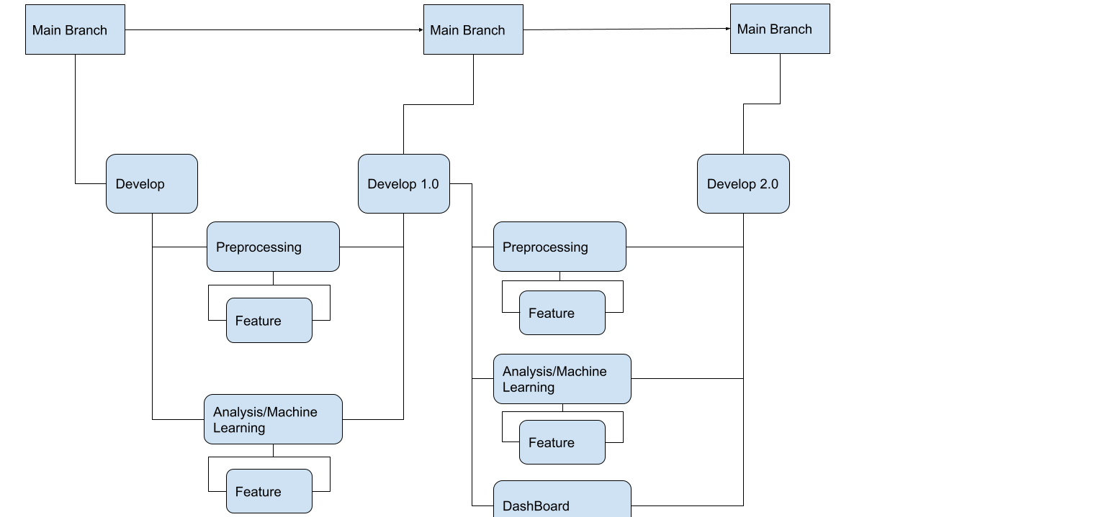
GitHub Structure/Communication Protocol
Notes:
Main Branch -Only merged with development folders that have been reviewed and acts as a 'final' submission -Is updated by by different development folders
Development Branch -Merged from sub-branches as defined by drawing, intended to be compiled work prior to review -Develop branch can be also updated from segment related changes (if any) -Contains all planning/notes made during the development -Create separate development branches based on weekly submissions
Preprocessing Branch -Contains all preprocessing & query related code for analysis/cleaning done on dataset -Completion of branch is merged to development branch upon collaborative review -Can be merged from feature branches pending collaborative review
Analysis Branch -Contains all machine learning related analysis code done given preprocessed data given from latest development update -Completion of branch is merged to development branch upon collaborative review -Can be merged from feature branches pending collaborative review
Presentation/Planning Branch -Contains all presentation related material including tableau presentation, google slides, and project explanations -Completion of branch is merged to development branch
Feature Branch -Contains any additional features members would like to add to existing code prior to collaboration session -These features will be reviewed collaboratively during session and merged with their respective branches

